Slide 1
LAS Liqo Autoscaling System

Slide 2
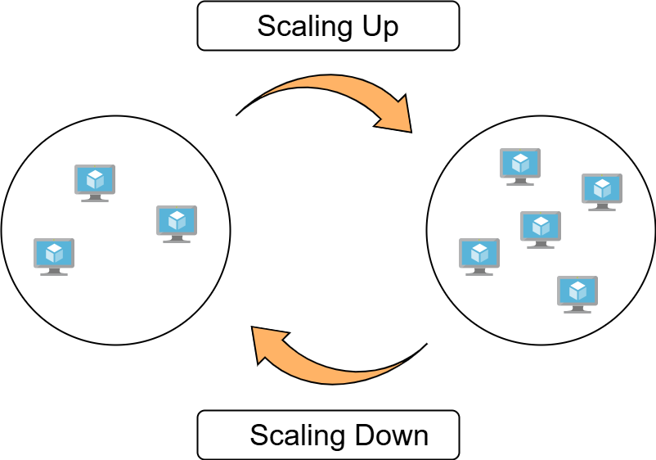
Cluster Autoscaling
Ability of a cluster to dynamically manage its number of nodes based on the current/future workload.
This feature is well established in a cloud ecosystems, but remains critical in on-premise environments.
1

Slide 3
Benefits of Liqo Dynamic Cluster Autoscaling
Challenges in on-premise environments:
Heterogeneous platform providers
Application constraints, including latency requirements, hardware dependencies, security, etc
Limited local resources
While cloud solutions efficiently address resource limitations, Liqo is better suited to handle the other types of challenges.
2

Slide 4
POC
Three main components:
Autoscaler: Software dedicated to detecting issues caused by resource shortages. In this POC, it was used the open-source Cluster Autoscaler, but it can be replaced with other systems.
Node Manager: Component responsible for managing nodes using Liqo features (adding/removing nodes, management via groups).
Discovery Server: Database containing information about available remote clusters for resource sharing.
12

Slide 5
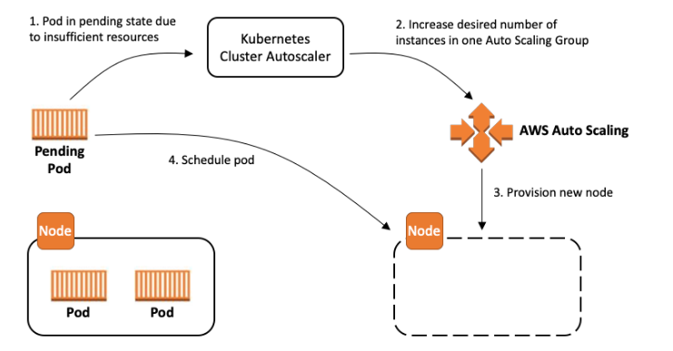
Cluster Autoscaler
Open-source tool, already integrated into many cloud ecosystems, based on monitoring pods. Its main purposes are:
Scale up: Trigger scaling when there are pods that cannot be scheduled due to lack of resources.
Scale down: Trigger scaling when a node is underutilized for an extended period and the pods on it can be rescheduled on other nodes.
To work with a new provider such as Liqo, it needs to use a gRPC server.
4

Slide 6
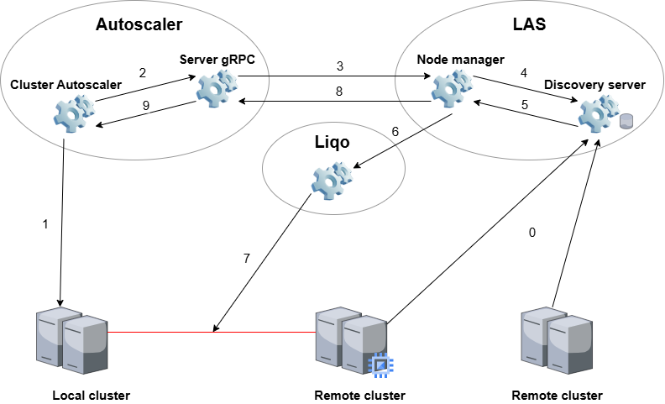
Scale up worflow

Slide 7
Next steps
Forecast autoscaler: The Cluster Autoscaler performs reactive scaling, initiating operations only when a problem arises. The next step in its evolution would be to replace this component with an autoscaler capable of predictive scaling features (e.g., DREEM by Miracapillo).
Discovery agent: Component responsible for periodically updating the database server with information about the resources available on each remote cluster.
12

Slide 8
12

